Slide 1

Final Engagement
Attack, Defence & Analysis of a Vulnerable Network

Slide 2



Summary
It was discovered that two VMs on the network were vulnerable to attack:
Target 1 - 192.168.1.110
Target 2 - 192.168.1.115
Each VM functions as an Apache web server and has SSH enabled, so ports 80 and 22 are possible ports of entry for attackers. A number of vulnerabilities were found.
Critical
High
Medium

Slide 3
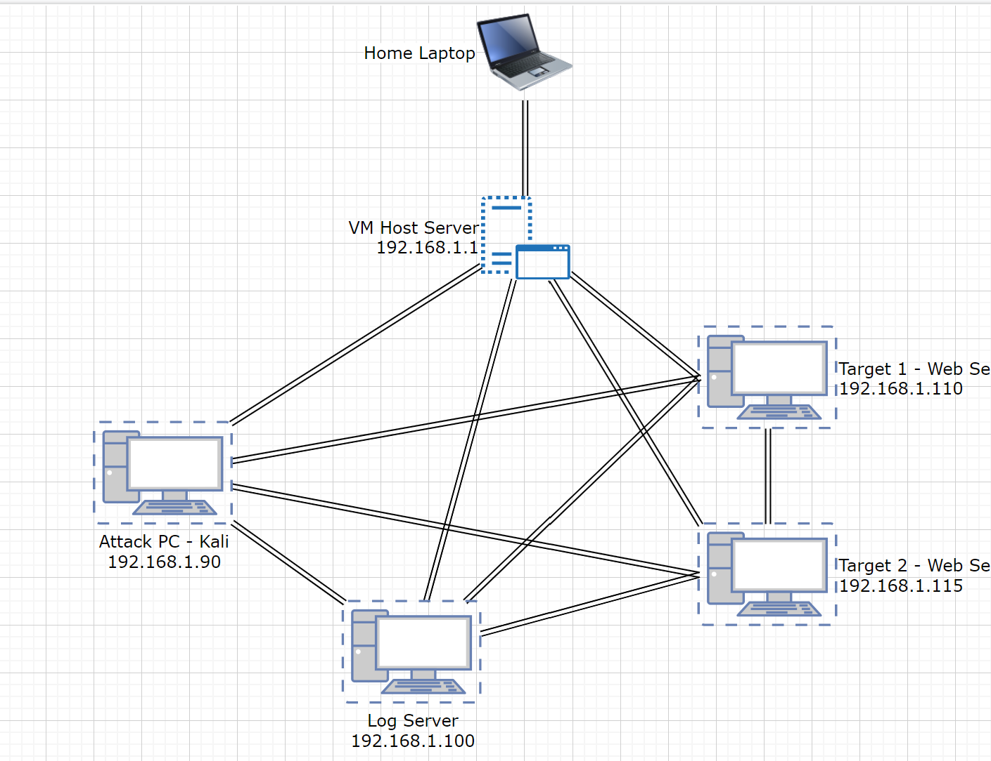
Network Topology
Network Address range: 192.168.1.0/24
Machines
VM Host Server (Windows 10) 192.168.1.1
Attack PC – Kali (Linux) 192.168.1.90
Log Server – ELK (Linux) 192.168.1.100
Target 1 (Linux) 192.168.1.110
Target 2 (Linux) 192.168.1.115

Slide 4

Reconnaissance

Slide 5
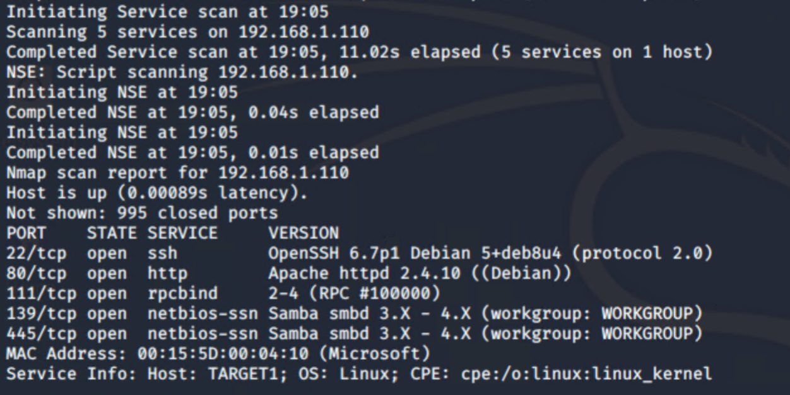
Nmap Target 1
Target 2

Slide 6
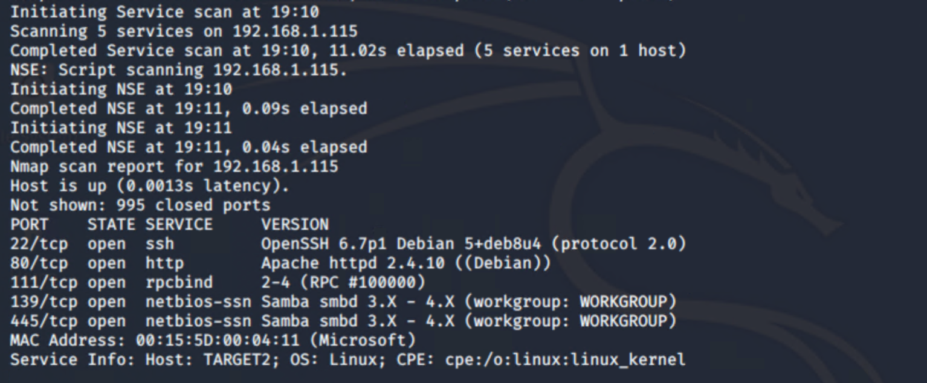
Nmap Target 2
Target 2

Slide 7
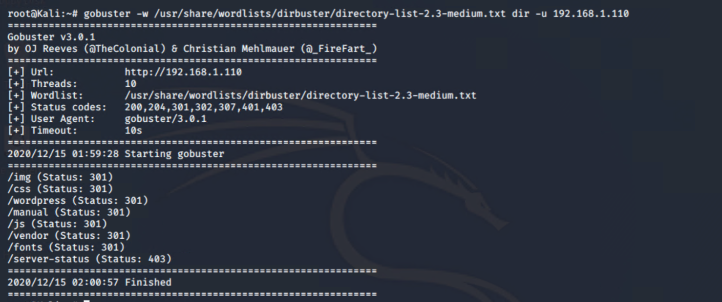
Gobuster Target 1

Slide 8
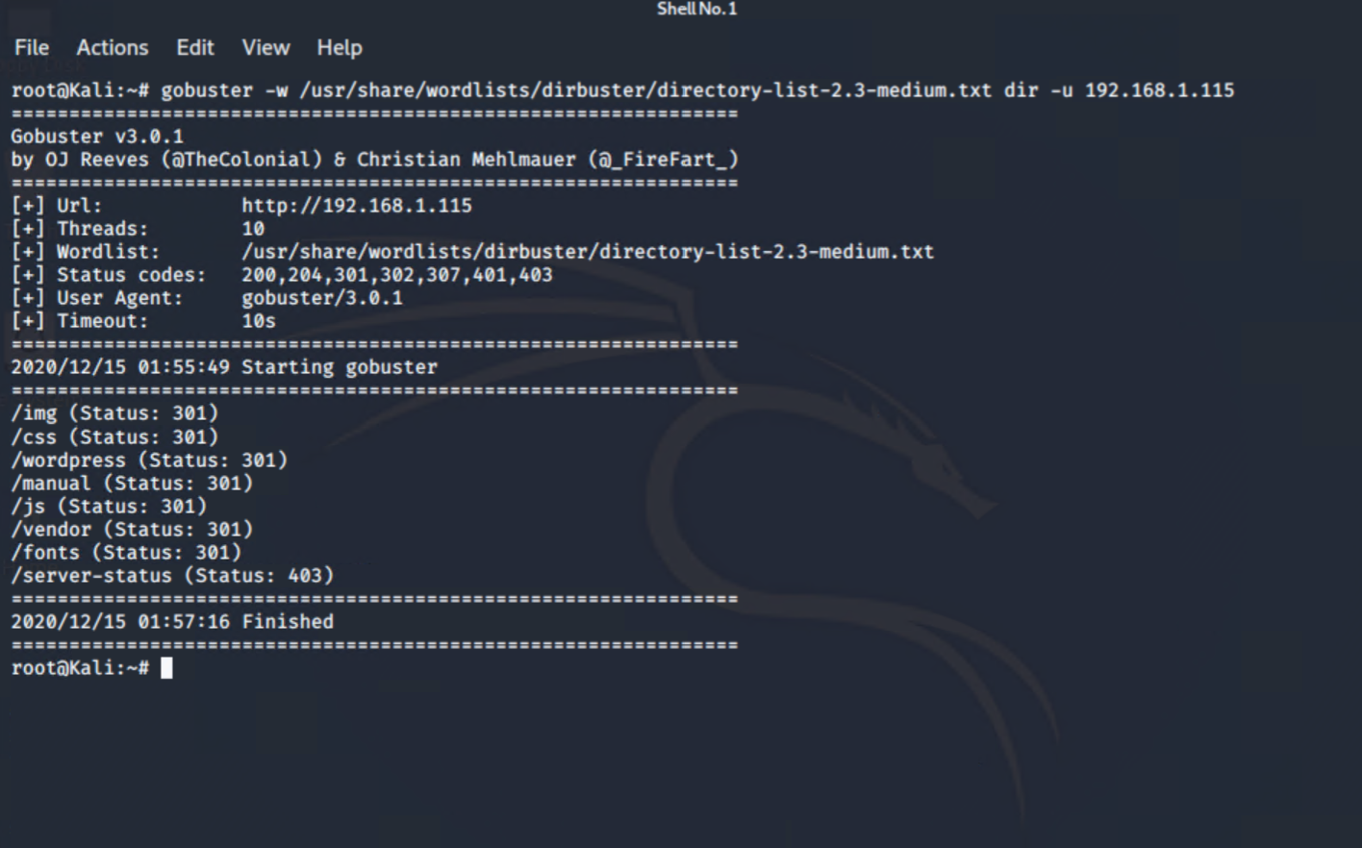
Gobuster Target 2

Slide 9
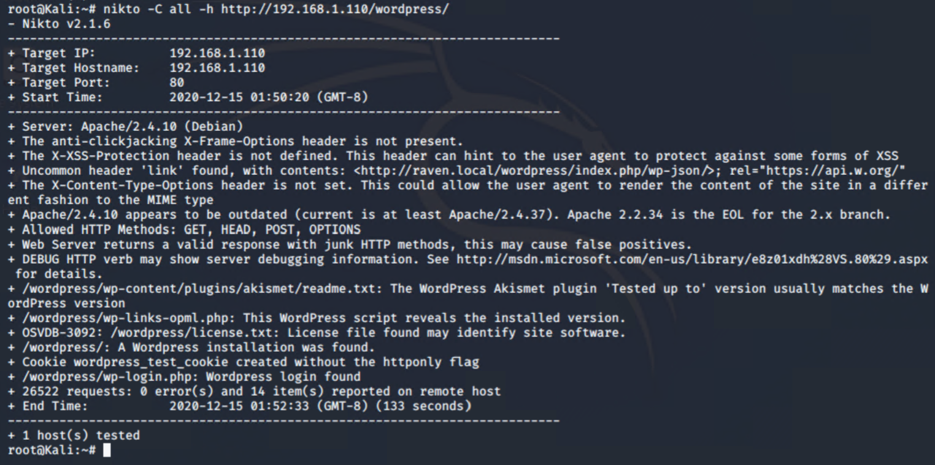
Nikto Target 1

Slide 10
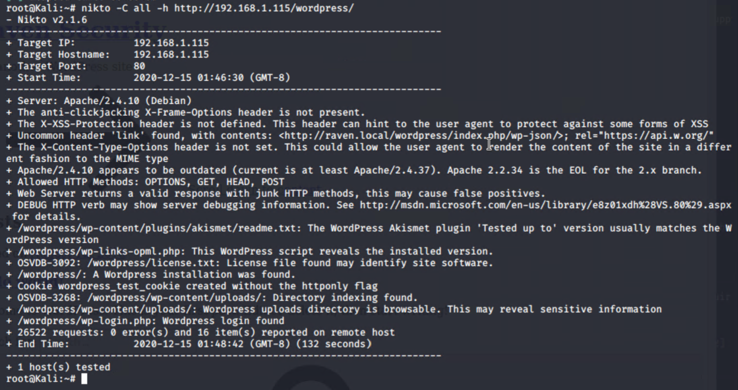
Nikto Taget 2

Slide 11
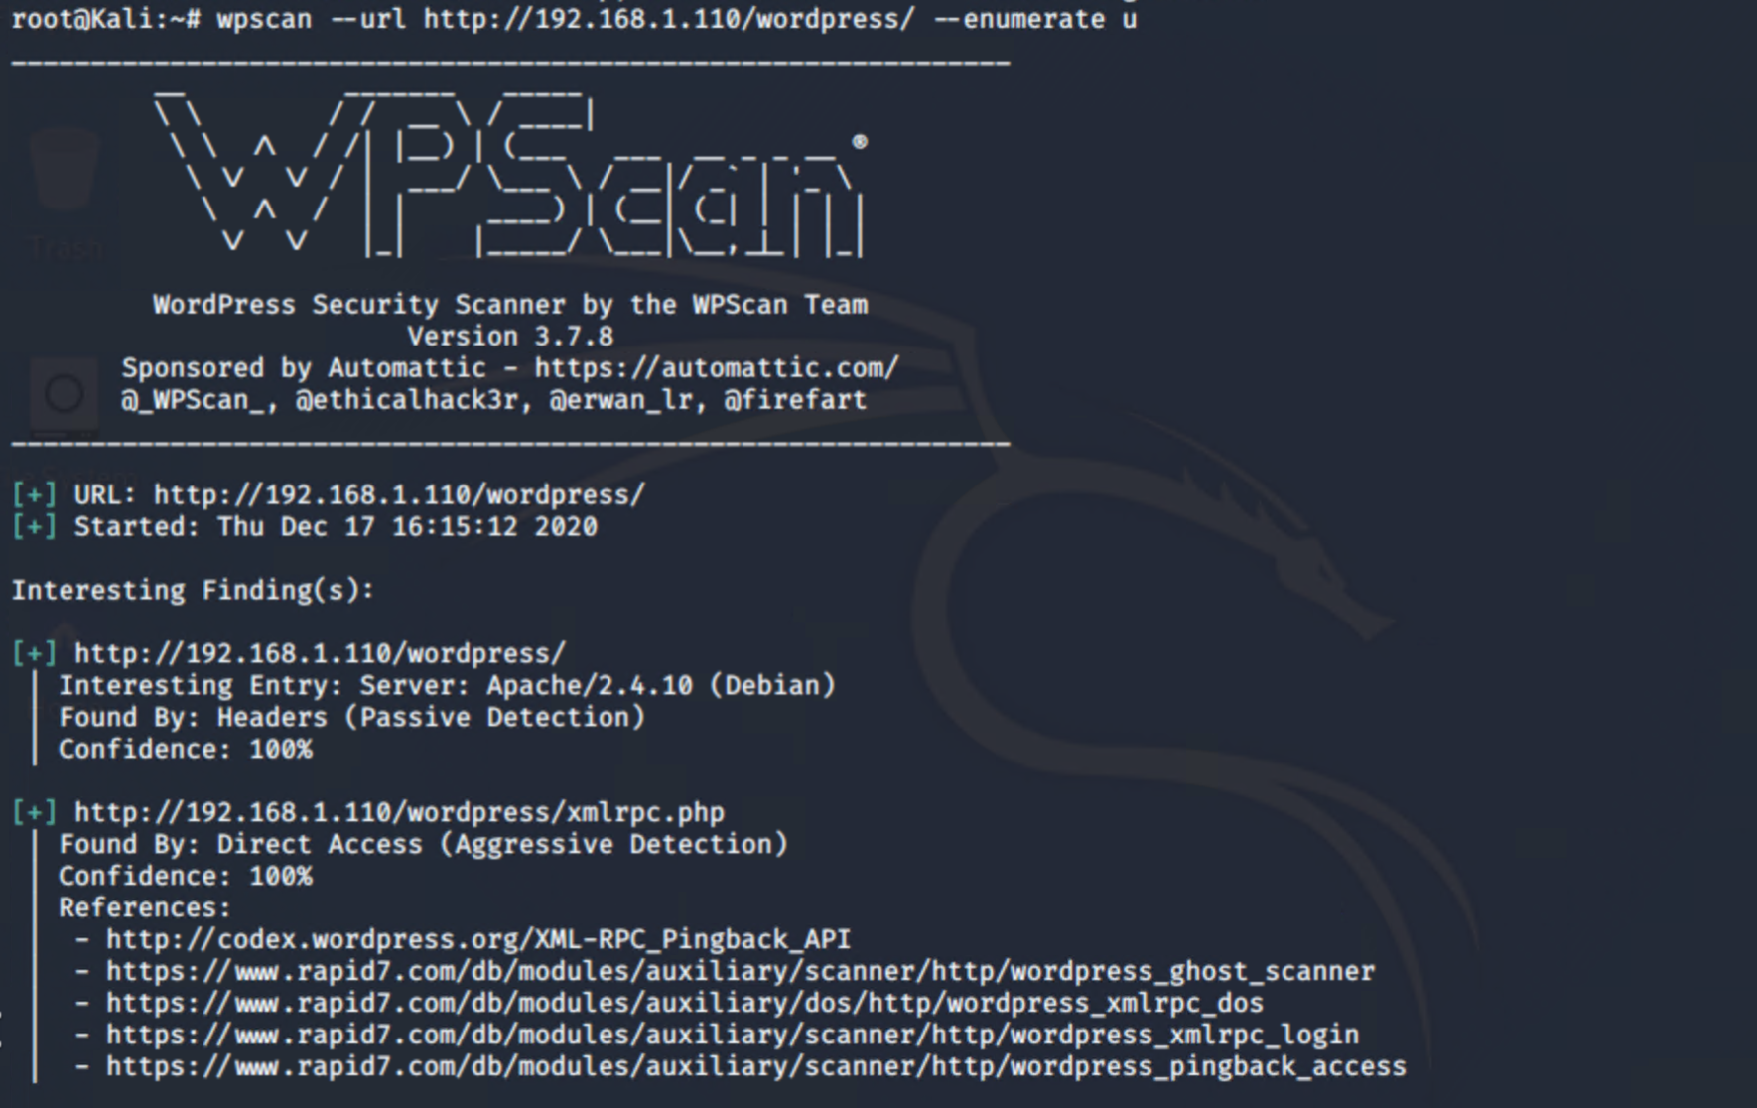
WPScan Target 1a

Slide 12
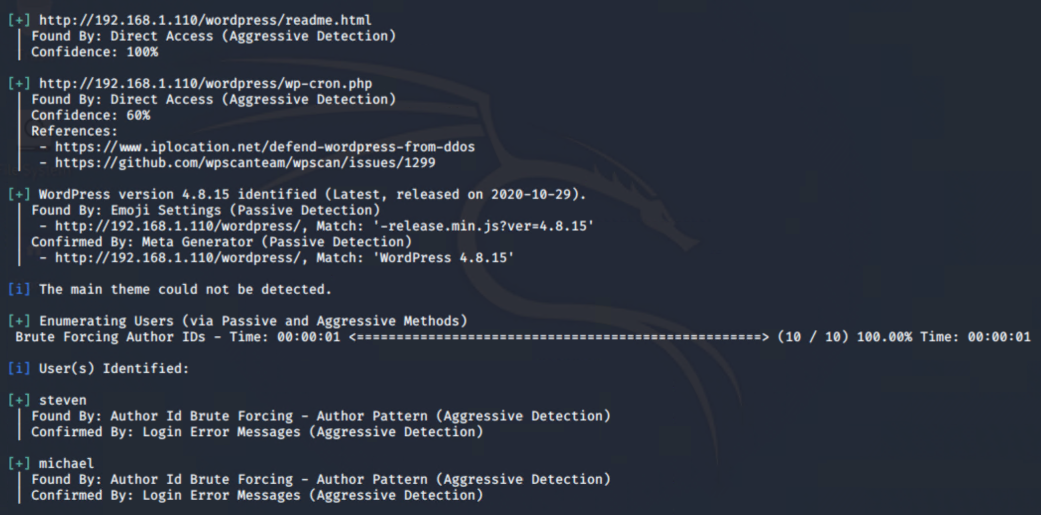
WPScan Target 1b

Slide 13
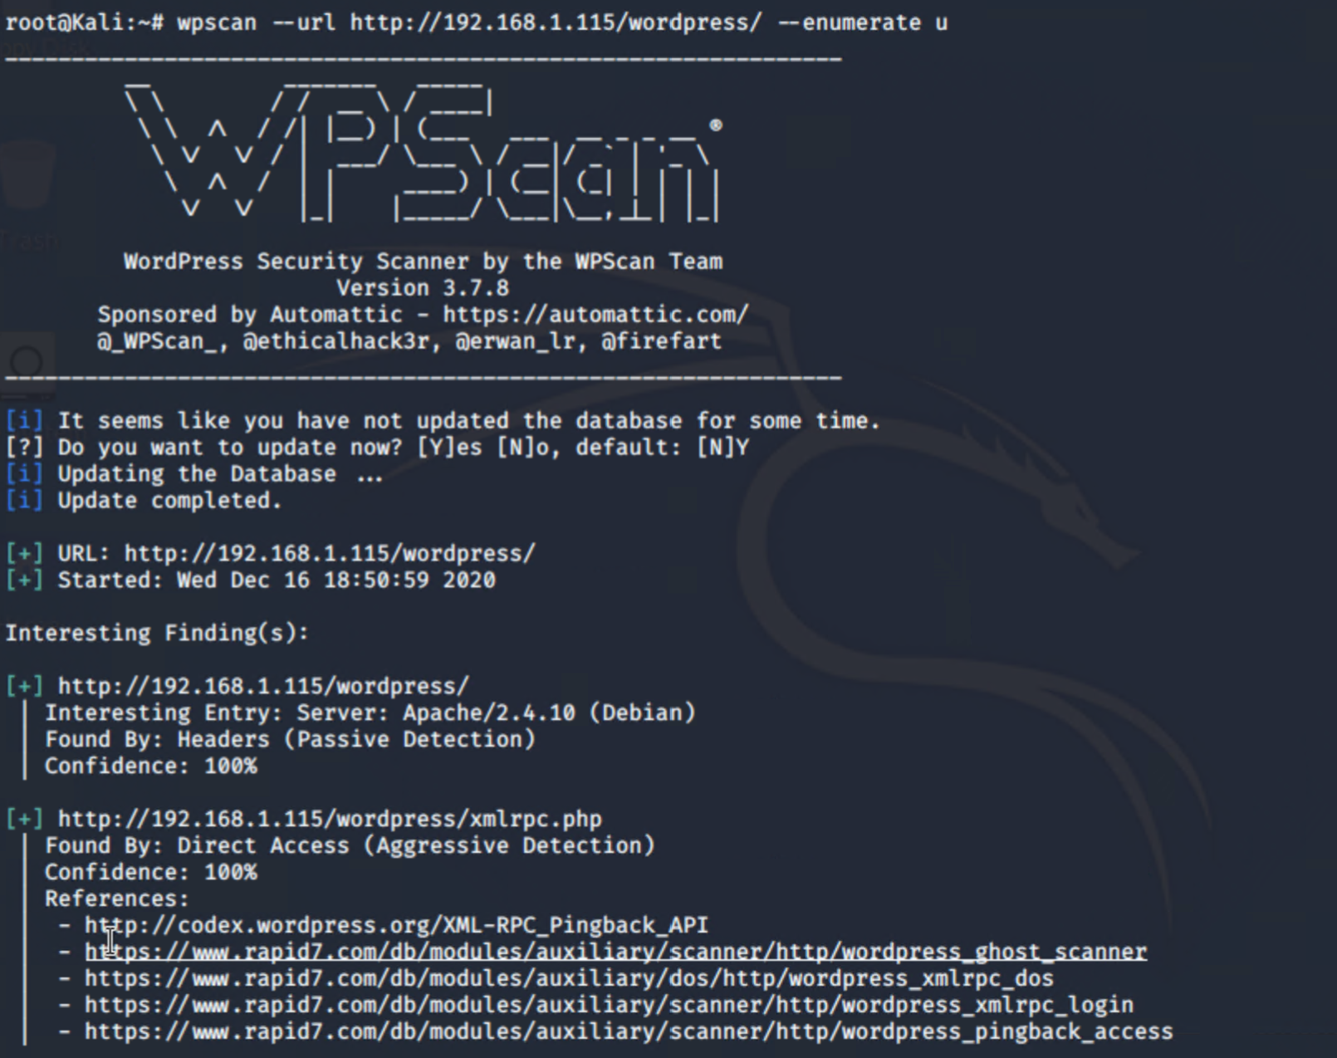
WPScan Target 2a

Slide 14
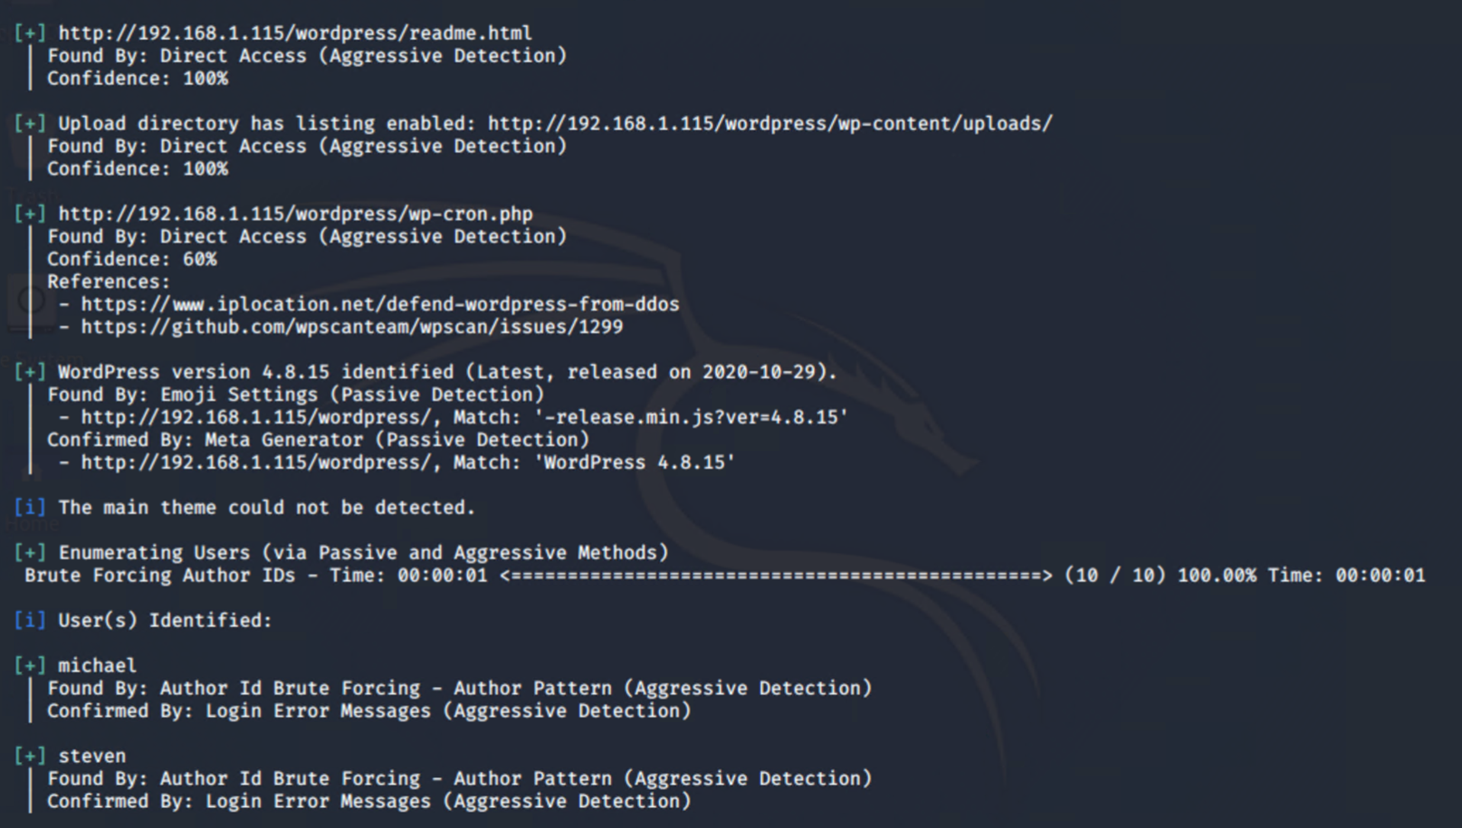
Wpscan Target 2b

Slide 15

Access, Exploration and Exploitation

Slide 16
Access
The previous scans showed a number of initial attack vectors to gain access to the web servers:
Open SSH version 6.7p1
Multiple vulnerabilities CVE-2016-6210, CVE-2016-6515, CVE-2015-8325
Permissions, Privileges and Access control CVE-2015-5600
HTTP port 80 open
OPTIONS, GET, HEAD and POST allowed
Apache version 2.4.10
Multiple vulnerabilities CVE-2017-7679, CVE-2017-7668, CVE-2017-3169, CVE-2017-3167
Wordpress version 4.8.15
Logins found, michael and steven
Upload directory is browsable
Version vulnerable to CVE-2020-4049
Rpcbind port 111 open version 2-4
Potential DoS attack CVE-2017-8779

Slide 17
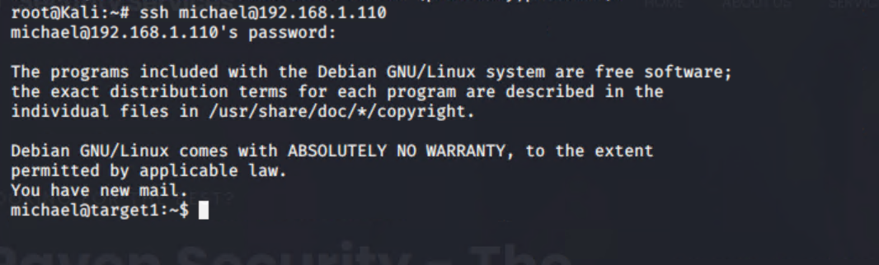
Target 1 Attack
The earlier wpscan with enumeration shows two users that we can use for an initial attack, micheal and steven. When attempting to connect with Micheal’s account it was easy to simply guess his password was michael.

Slide 18
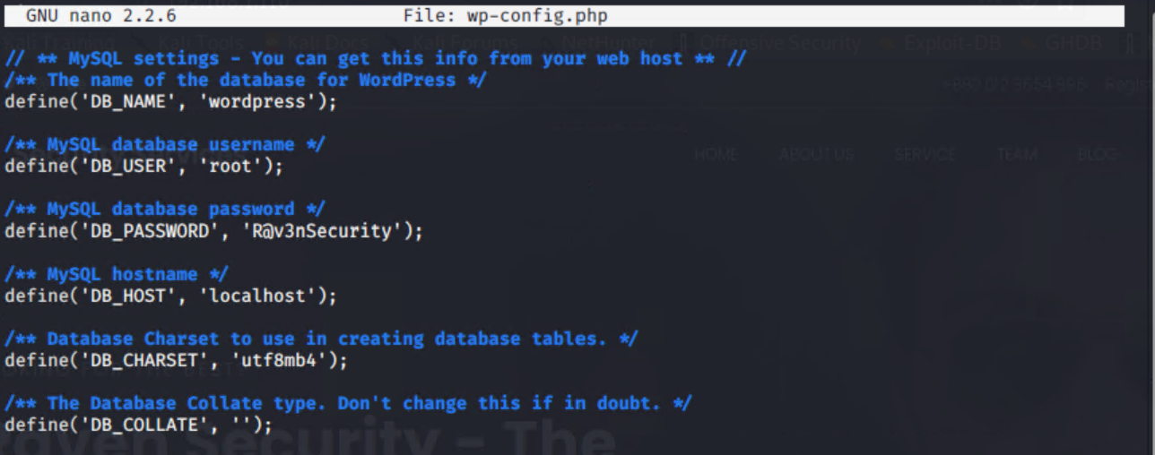
Target 1 Attack (cont.)
Using micheals account it was possible to navigate to /var/www/html and view the wp-config.php file

Slide 19
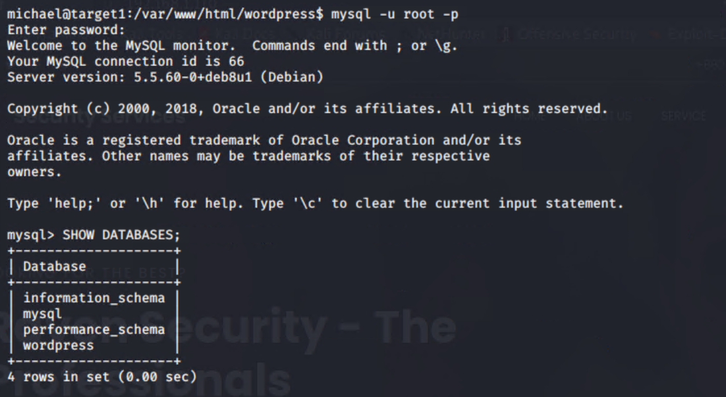
Target 1 Attack (cont.)
With the revealed root password a MYSQL connection could be made

Slide 20
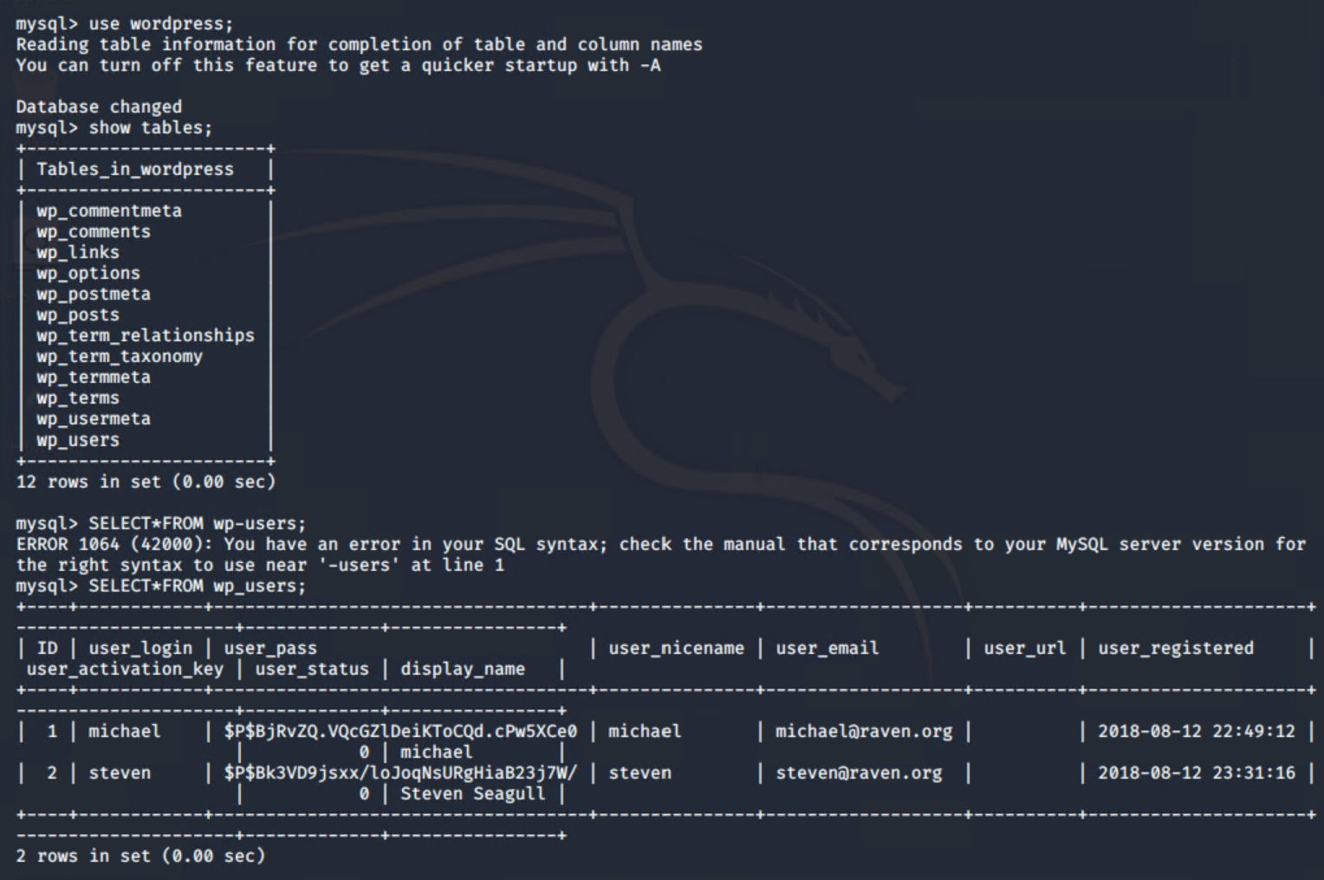
Target 1 Attack (cont.)
The user account password hashes could then be exposed

Slide 21
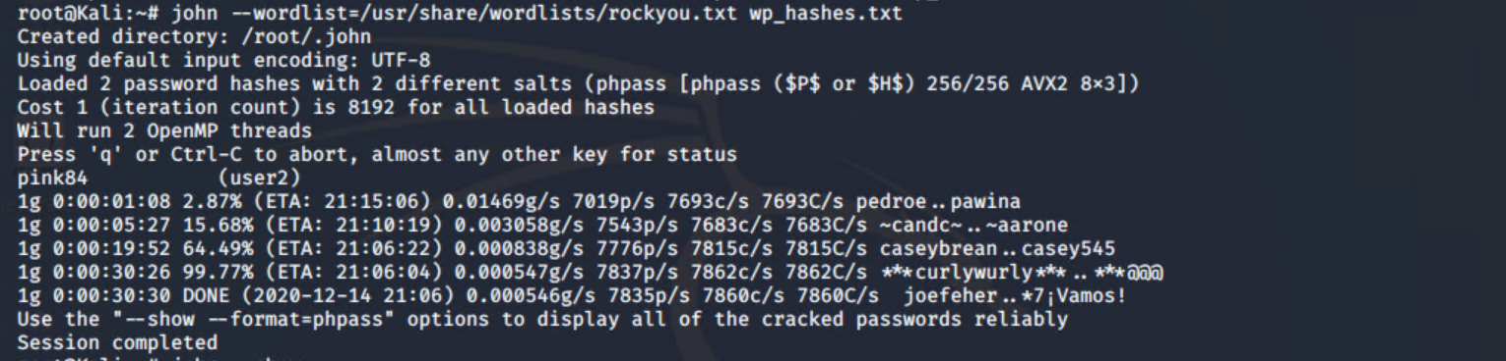
Target 1 Attack (cont.)
Using john the ripper it was possible to crack Steven’s password – pink84

Slide 22
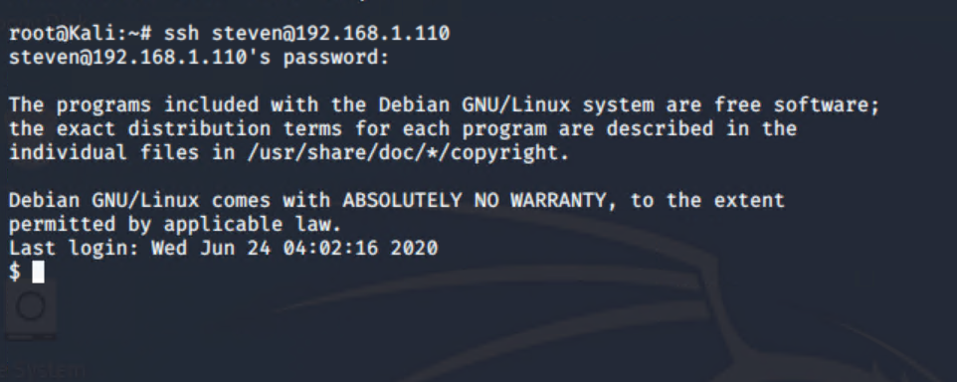
Target 1 Attack (cont.)
An ssh connection using stevens credentials was then completed

Slide 23
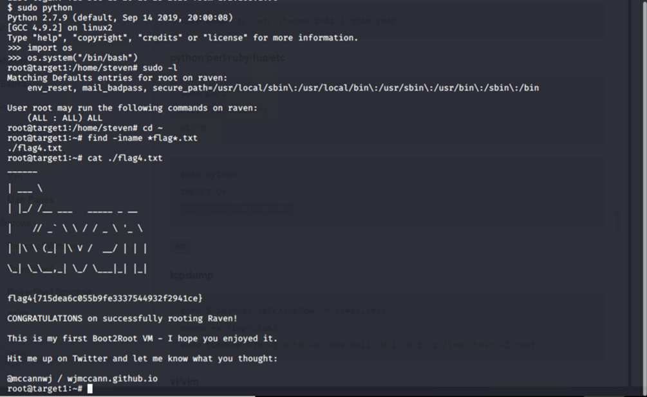
Target 1 Attack (cont.)
Escalation to root account was completed using a sudo python hack.

Slide 24

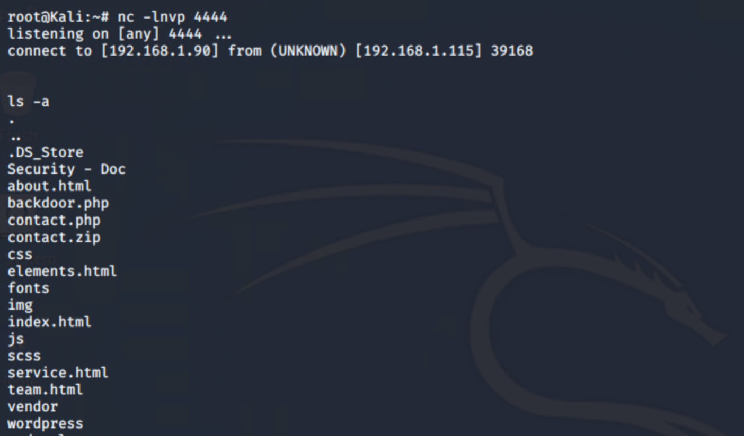
Target 2 Attack
Target 2 was compromised by using a vulnerability to command injection attacks to open a reverse shell

Slide 25
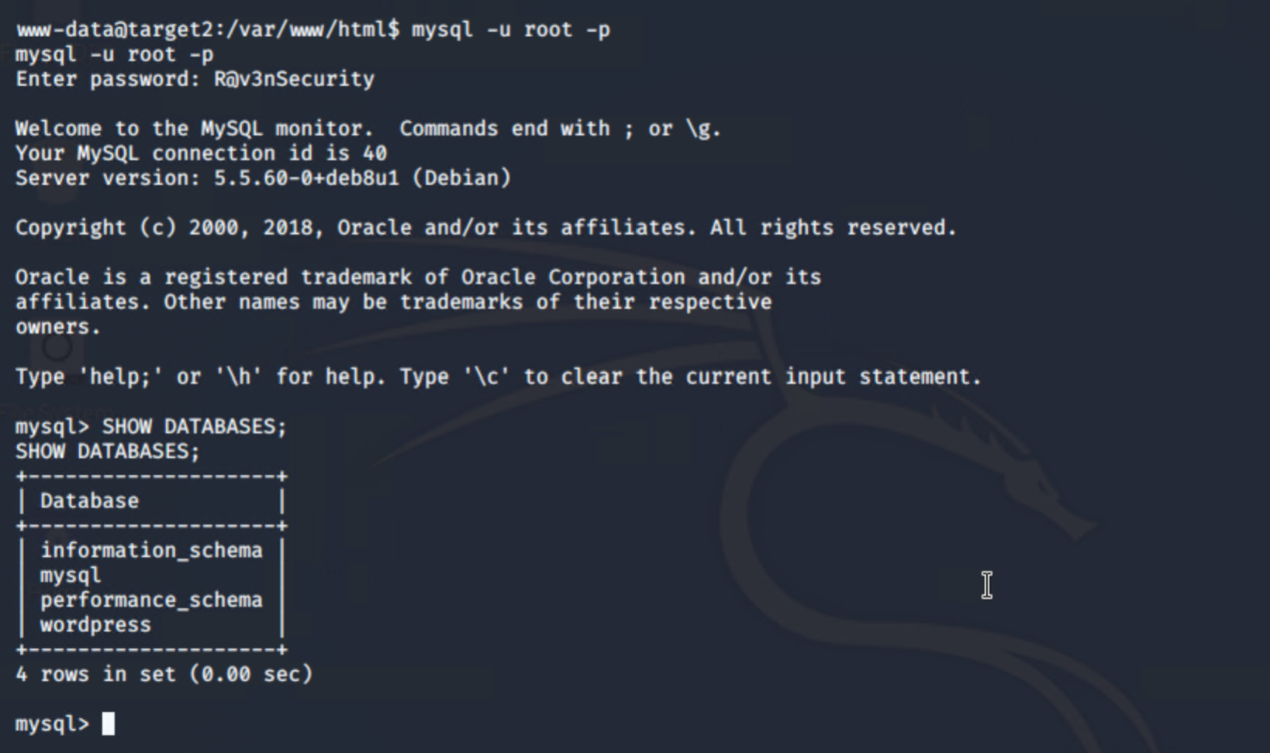
Target 2 Attack (cont.)
As with Target 1 MYSQL credentials were available and a connection could be made

Slide 26
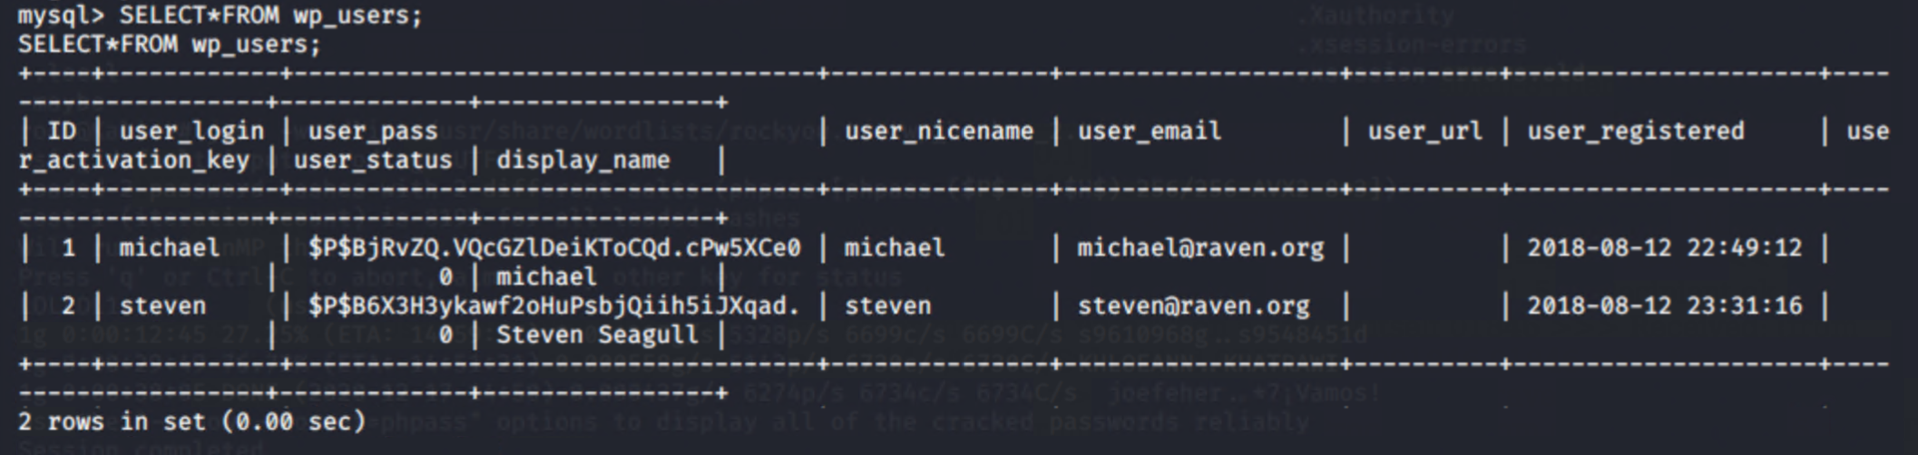
Target 2 Attack (cont.)
Password hashes could be shown

Slide 27
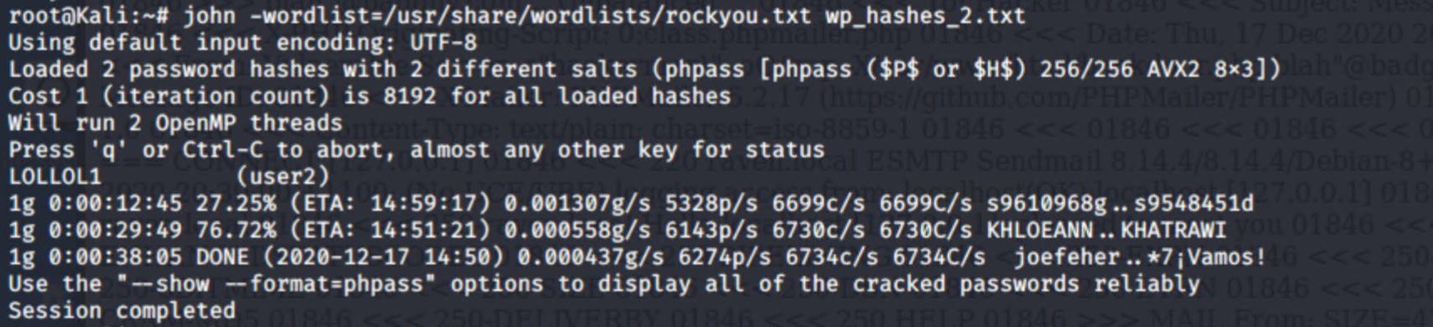
Target 2 Attack (cont.)
John the ripper was able to crack user 2 steven

Slide 28
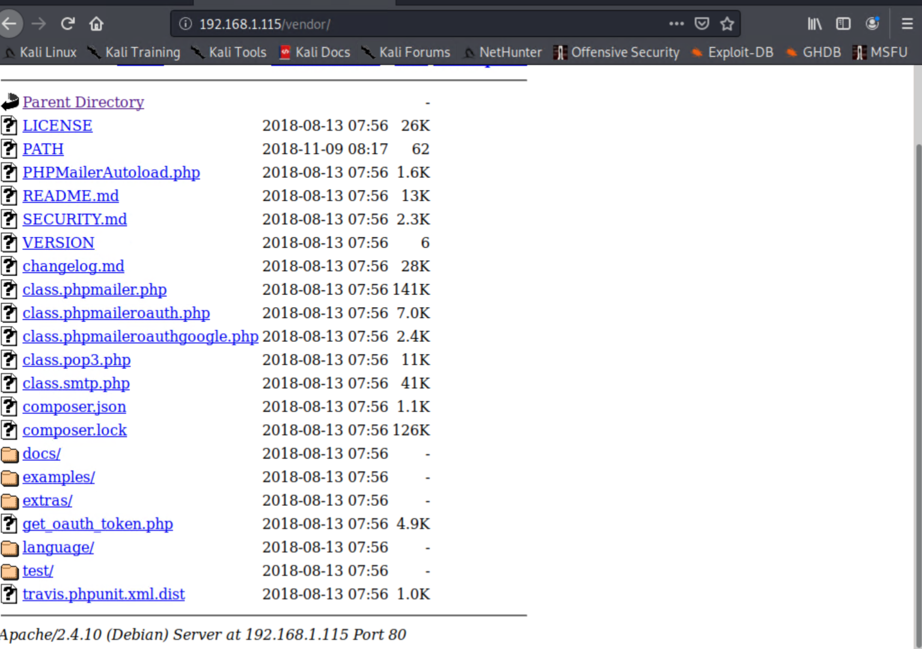
Target 2 Attack (cont.)
Navigating to the /vendor folder showed phpmailer. The /VERSION folder shows version 5.2.16

Slide 29
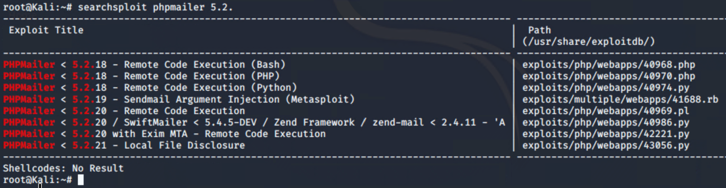
Target 2 Attack (cont.)
Searchsploit exposed a number of vulnerabilities

Slide 30

Vulnerabilities, Mitigation and Hardening

Slide 31
Vulnerability: Open SSH version 6.7p1
CVE-2016-6210:
Rating: 5.9 Medium
CVE-2016-6515:
Rating: 7.5 High
CVE-2015-8325:
Rating: 7.8 High
CVE-2015-5600:
Rating: N/A
Mitigation: Upgrade OpenSSH to version 7.3 or later

Slide 32
Vulnerability: SSH General Hardening
General security mitigation for SSH:
Disable empty passwords
Limit max authentication attempts
Disable Root Login
Strong passwords/passphrase for ssh users and keys
Keep SSH updated

Slide 33
Vulnerability: Apache version 2.4.10
CVE-2017-7679:
Rating: 9.8 CRITICAL
CVE-2017-7668:
Rating: 9.8 CRITICAL
CVE-2017-3169:
Rating: 9.8 CRITICAL
CVE-2017-3167:
Rating: 9.8 CRITICAL
Mitigation: Upgrade Apache to version 2.4.26 or later

Slide 34
Vulnerability: Wordpress version 4.8.15
CVE-2020-4049:
Rating: 2.4 Low
Mitigation: Upgrade Wordpress to version 5.4.2
General security mitigation for wordpress:
Rename the administrative account
Enforce strong passwords and 2 Factor authentication
Use SFTP encryption
Limit file permissions
Require an HTTPS SSL encrypted connection for administration

Slide 35
Vulnerability: rpcbind Version 2-4
CVE-2017-8779:
Rating: 7.5 High
Mitigation: upgrade rpcbind version to 2-5 or later

Slide 36
Vulnerability: PHPMailer Version 5.2.16
CVE-2018-19296:
Rating: 8.8 High
CVE-2017-5223:
Rating: 5.5 Medium
CVE-2016-10033:
Rating: 9.8 Critical
CVE-2016-10045:
Rating: 9.8 Critical
Mitigation: Upgrade to PHPMailer 6.2.0 or later

Slide 37
Vulnerability HTTP General Hardening
General security mitigation for HTTP:
Hide PHP information
Hide the web server version
Enable HSTS
Use the X-Frame-Options header to deny iframes.
Disable HTTP enforce HTTPS and use only TLS 1.2

Slide 38
Best Practise
Educate employees on appropriate and safe behaviour
Initiate privileged access control measures
Use multi-factor authentication
Implement network segmentation and segregation
Monitor systems continually and regularly check logs
Keep all security patches and software versions up to date

